Slide 1
Solid Edge Developer Assembly
Art Patrick – Solid Edge Assembly

Slide 2
Agenda
Addin for SE Assembly
Uses UI Sample from Codeplex
Edgebar Pane
Addin Commands
SE Mouse Control

Slide 3
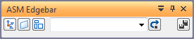
SE ASM Edgebar Addin
Action Object Display toggles for occurrences
Query and select occurrences
Replace Part with Copy and Auto-Rename
Commands always availablec

Slide 4
CodePlex Sample
https://solidedgesamples.codeplex.com/
UI_Sample
Copied SolidEdge.AddIn.Common
Edgebar and other command UI Classes
Addin helper files

Slide 5
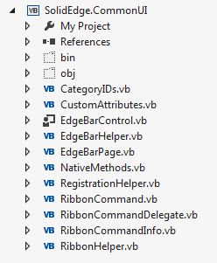
SolidEdge.AddIn.Common
CommonUI.dll
Addin helper files:
CategoryIDs
CustomAttributes
NativeMethods
EdgeBar files:
EdgeBarControl – (User Control)
EdgeBarHelper
EdgeBarPage

Slide 6
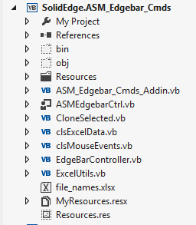
ASM_Edgebar_Cmds Files
SolidEdge.ASM_Edgebar_Cmds.dll
ASM_Edgebar_Cmds_Addin
EdgeBarController
ASMEdgebarCtrl
User Control based on EdgeBarControl
clsMouseEvents
Performs actions/Mouse selection
CloneSelected
Copies and replaces selected components
Auto-Names from Excel List

Slide 7
Tricks/Tips
Make XLS disconnect at Addin Level (One and Only One connection)
Mouse Selection in ASM while IPA Re-curse to get a reference based on the Top-level ASM.
Create one Edgebar per open ASM Document Use Document as Key in Edgebar Collection
Careful with file_names.xls Debug point to Release folder Copy if newer on project

Slide 8
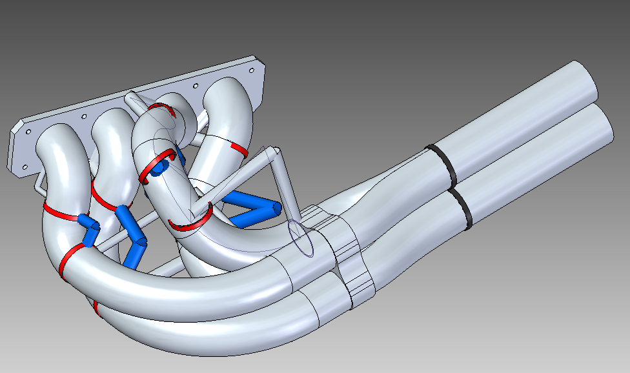
Demonstration
Let’s take a look

Slide 9
Assembly Developer
Questions?

Slide 10

Solid Edge Developer Assembly
Be sure to check out:
Large Assembly
Top Down Assembly Design
Assembly Design
Assembly Round Table
Thank You

